Slide 1
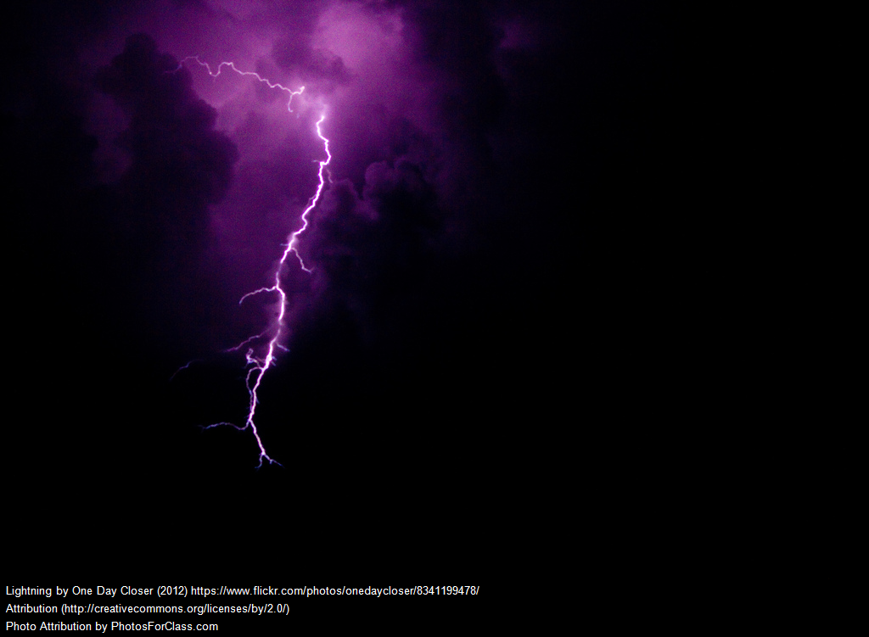
Why You Should Publish Your Crappy Script

Slide 2
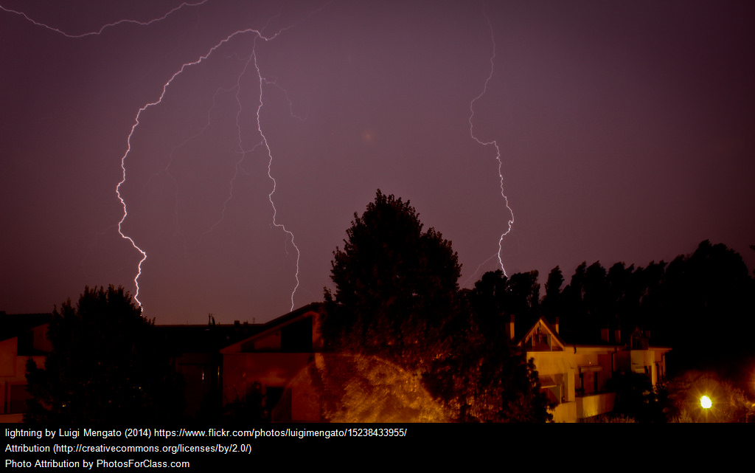
You’ll write better crappy scripts
Knowing others will be looking at your code, you’ll be encouraged to…
Comment your code better. You’ll want others to understand it, but that means you will when you look at it next year.
Write more flexible code. You’ll add those options you would otherwise leave out. Like making your script delete instead of just adding.
Write overall better code. Those awful shortcuts you took? You’ll have an incentive to work through them and make them a little better.

Slide 3

Other people will improve on your crappy script
Maybe they will. Maybe they won’t. But now improvements can be tracked in the versioning system.
As can feature requests!
And complaints!
When you react to those, you’ll make your script better.

Slide 4

You stole the code for your crappy script
You probably got it off all stackexchange anyway, right?
This is your chance to get that example out of stackexchange and into a maintained versioning system. Just like the original author would have done, if he’d come to this talk!

Slide 5

You can show off your crappy script
If you want to… maybe you don’t? But if this is the first time you publish a crappy script, you can use it to learn some new skills that will benefit you the next time around, like keeping your code in a version control system. Next time you’ll already have this knowledge.
You can work towards having a repository of less
and less crappy scripts, and eventually having
something you actually want to show off.

Slide 6

You’ll be able to find your crappy script
Next time you need that snippet of code you created years ago, would you rather grep your home dir for something you think might be in it, or go find it on your repo?
If you copy and paste your crappy script, improvements to it never make it back to the old versions. Next time you go to copy and paste it, are you using the most recent? If you version control, you can always find the latest, right where you put it.

Slide 7
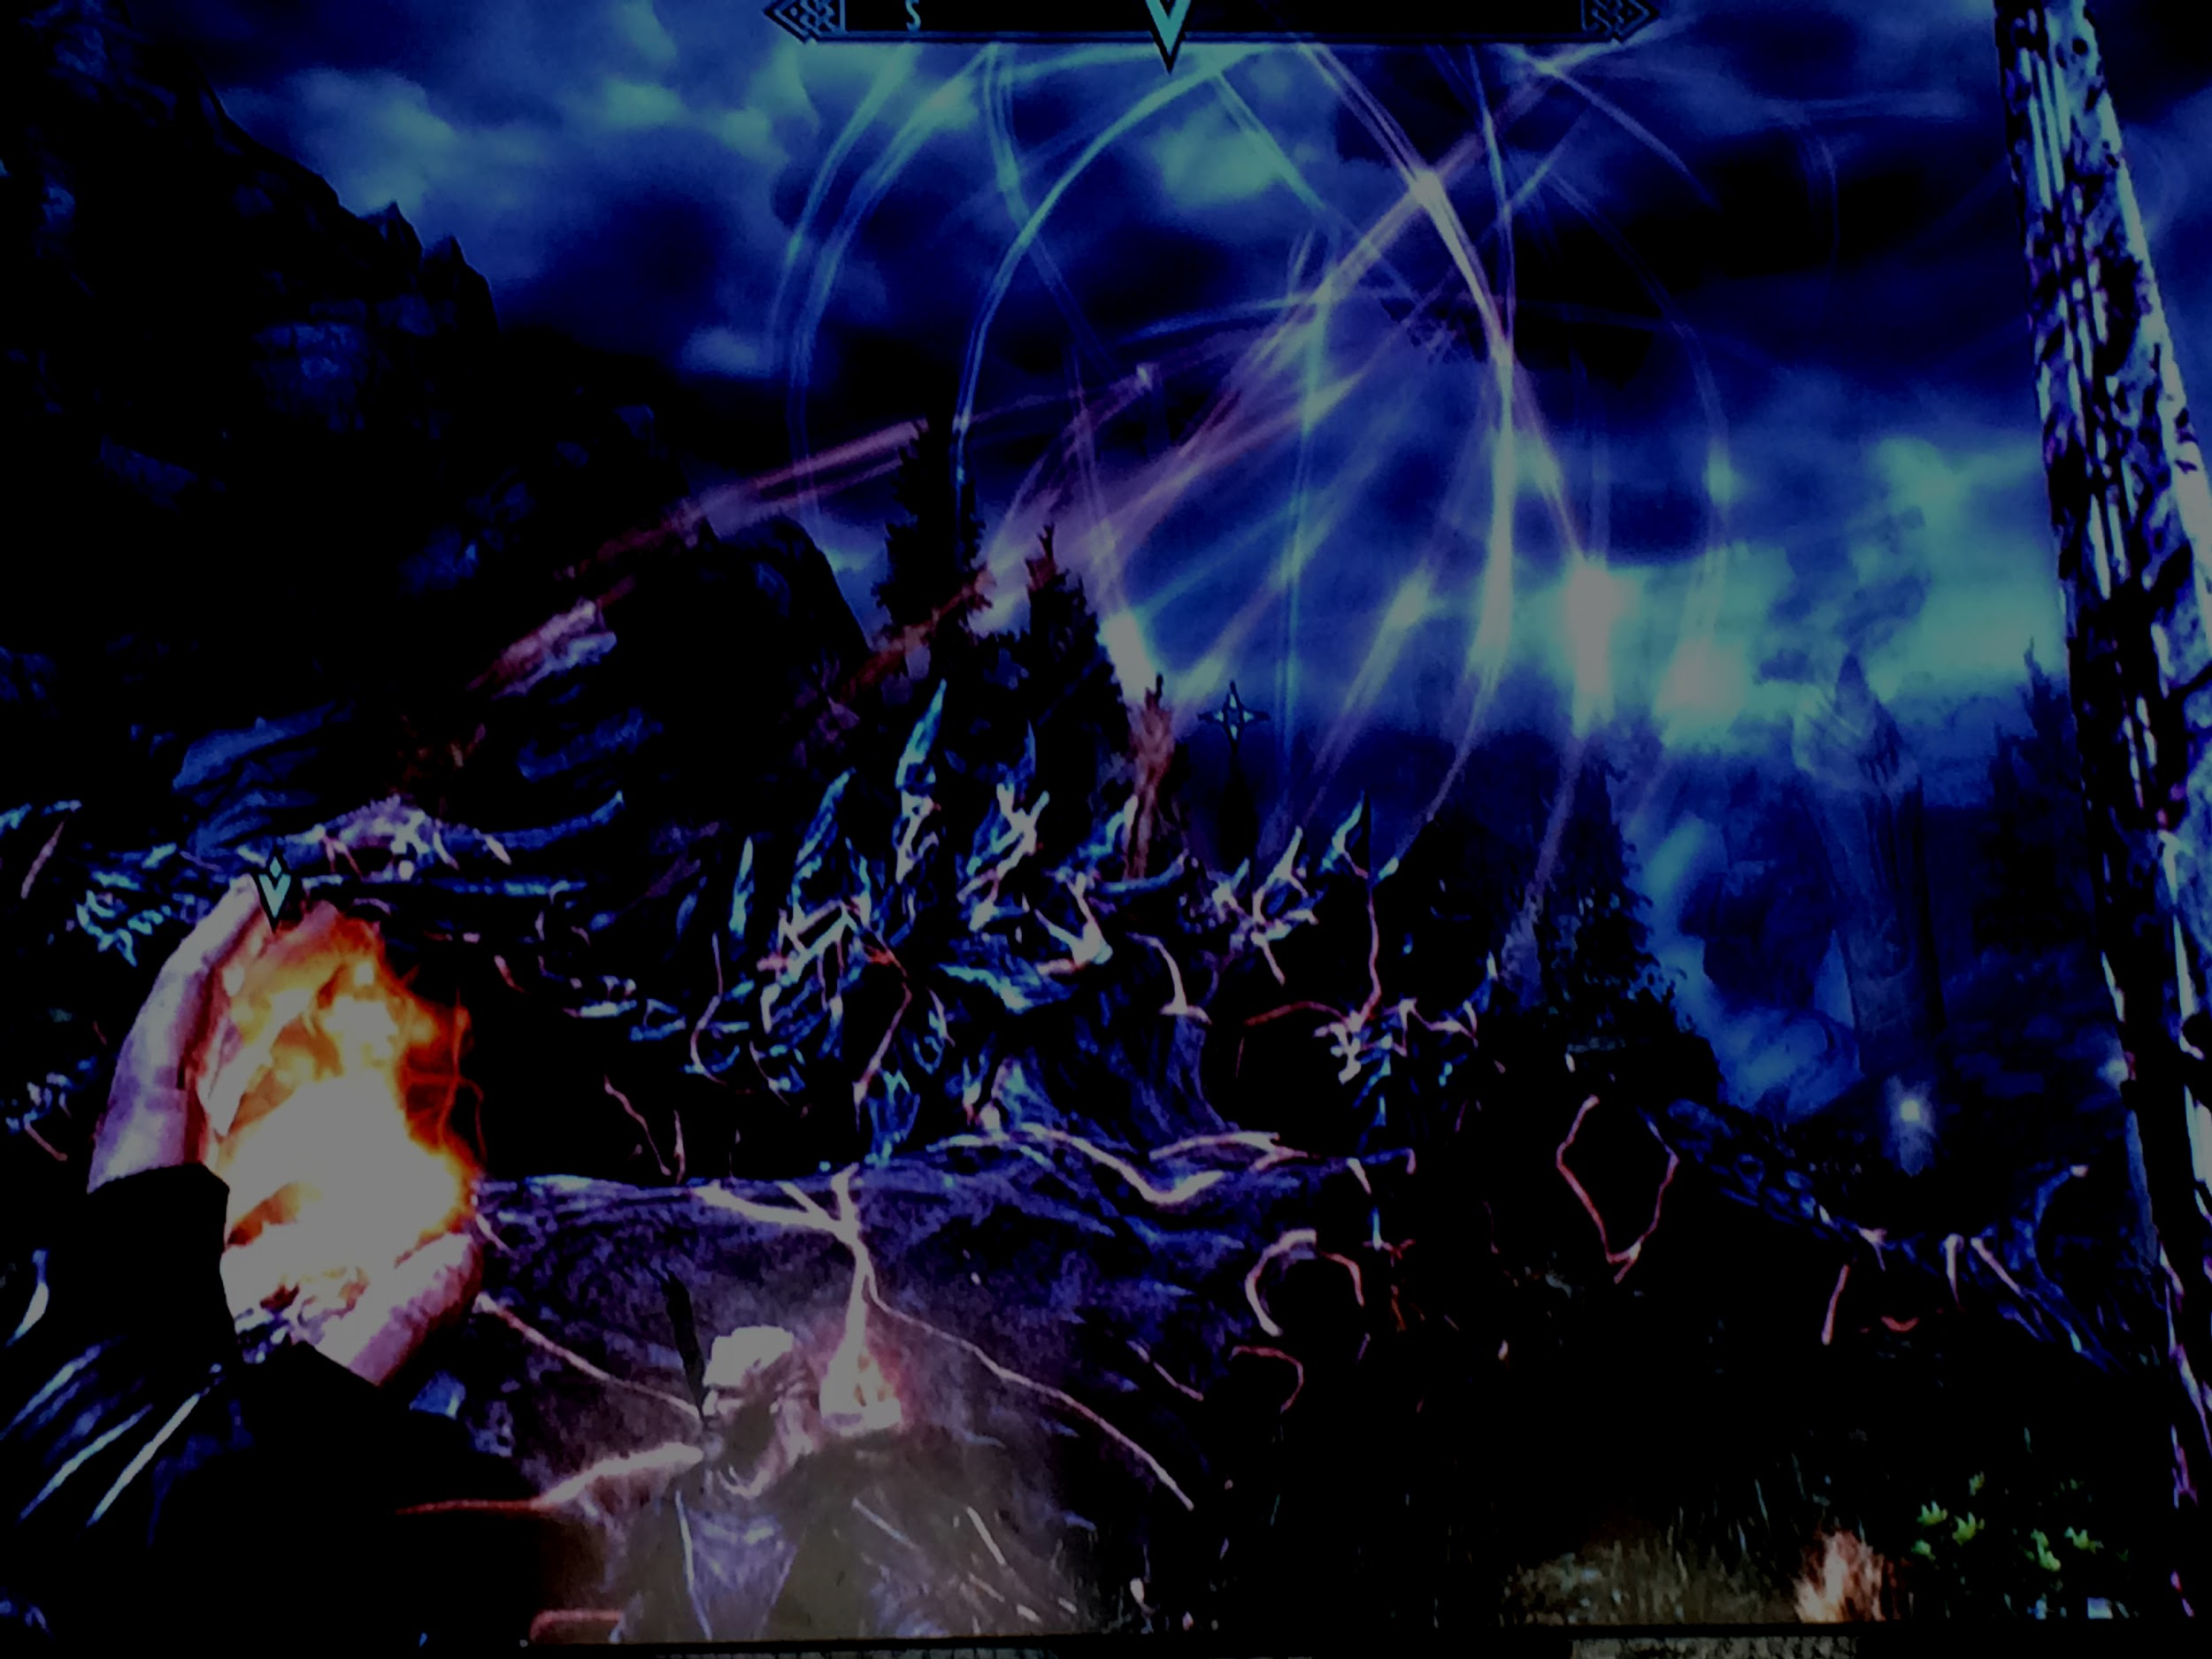
You stand on the shoulders of giants who wrote crappy scripts. Now it’s your turn.
This giant mess of open source code doesn’t happen by accident. Sharing code means we all benefit, with better code, more examples for the next generation of programmer, and the opportunity to learn.
Get out there, and write some crappy scripts.

Slide 8
A Lightning Talk
FOSSCON 2017
Jonathan Simpson
This work is licensed under a Creative Commons Attribution 4.0 International License.

